Slide 1
Computer Vision
Dr Ossama Alshabrawy Ossama.Alshabrawy@northumbria.ac.uk

Slide 2
What is Computer Vision?
Computer vision is an area of artificial intelligence (AI) in which software systems are designed to perceive the world visually world and make sense of it.
through cameras, images, and video.
There are multiple specific types of computer vision problem that AI engineers and data scientists can solve using a mix of custom machine learning models and platform-as-a-service (PaaS) solutions - including many AI services in Microsoft Azure.

Slide 3
How the computer see
Each digital image is actually an array of numeric values indicating the color intensity of each pixel in the image. Each number is a value between 0 and 255, representing the intensity of each pixel
You can use these values just like any other data as features to train a machine learning model, or to apply transformations and calculations to analyze the image data and find patterns in it.
In the case of color images, there are three layers of pixel values for red, green, and blue intensities.

Slide 4

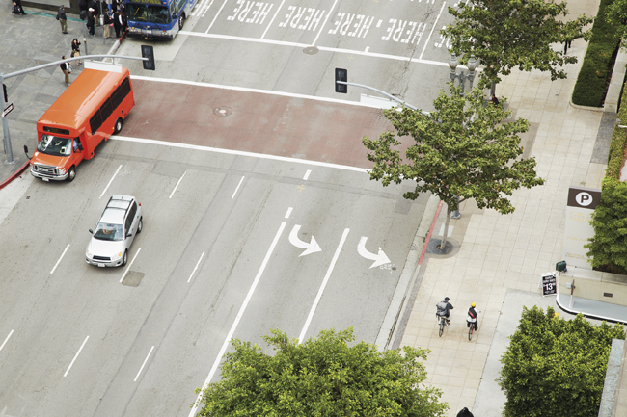


What is Computer Vision?
0 | 255 | 0 | 255 | 0 | 255 | 0 | 255 | 0 | 255 | 0 | 255 | 0 | 255 | 0 | 255 | 0 | 255 | 0 | 255 | 0 | 255 | 0 | 255 | 0 | 255 | 0 | 255 | 0 | 255 | 0 | 255 | 0 | 255 | 0 | 255 | 0
0 | 255 | 0 | 255 | 0 | 255 | 0 | 255 | 0 | 255 | 0 | 255 | 0 | 255 | 0 | 255 | 0 | 255 | 0 | 255 | 0 | 255 | 0 | 255 | 0 | 255 | 0 | 255 | 0 | 255 | 0 | 255 | 0 | 255 | 0 | 255 | 0
0 | 255 | 0 | 255 | 0 | 255 | 0 | 255 | 0 | 255 | 0 | 255 | 0 | 255 | 0 | 255 | 0 | 255 | 0 | 255 | 0 | 255 | 0 | 255 | 0 | 255 | 0 | 255 | 0 | 255 | 0 | 255 | 0 | 255 | 0 | 255 | 0
0 | 255 | 0 | 255 | 0 | 255 | 0 | 255 | 0 | 255 | 0 | 255 | 0 | 255 | 0 | 255 | 0 | 255 | 0 | 255 | 0 | 255 | 0 | 255 | 0 | 255 | 0 | 255 | 0 | 255 | 0 | 255 | 0 | 255 | 0 | 255 | 0
0 | 255 | 0 | 255 | 0 | 255 | 0 | 255 | 0 | 255 | 0 | 255 | 0 | 255 | 0 | 255 | 0 | 255 | 0 | 255 | 0 | 255 | 0 | 255 | 0 | 255 | 0 | 255 | 0 | 255 | 0 | 255 | 0 | 255 | 0 | 255 | 0
0 | 255 | 0 | 255 | 0 | 255 | 0 | 255 | 0 | 255 | 0 | 255 | 0 | 255 | 0 | 255 | 0 | 255 | 0 | 255 | 0 | 255 | 0 | 255 | 0 | 255 | 0 | 255 | 0 | 255 | 0 | 255 | 0 | 255 | 0 | 255 | 0
0 | 255 | 0 | 255 | 0 | 255 | 0 | 255 | 0 | 255 | 0 | 255 | 0 | 255 | 0 | 255 | 0 | 255 | 0 | 255 | 0 | 255 | 0 | 255 | 0 | 255 | 0 | 255 | 0 | 255 | 0 | 255 | 0 | 255 | 0 | 255 | 0
0 | 255 | 0 | 255 | 0 | 255 | 0 | 255 | 0 | 255 | 0 | 255 | 0 | 255 | 0 | 255 | 0 | 255 | 0 | 255 | 0 | 255 | 0 | 255 | 0 | 255 | 0 | 255 | 0 | 255 | 0 | 255 | 0 | 255 | 0 | 255 | 0
0 | 255 | 0 | 255 | 0 | 255 | 0 | 255 | 0 | 255 | 0 | 255 | 0 | 255 | 0 | 255 | 0 | 255 | 0 | 255 | 0 | 255 | 0 | 255 | 0 | 255 | 0 | 255 | 0 | 255 | 0 | 255 | 0 | 255 | 0 | 255 | 0
0 | 255 | 0 | 255 | 0 | 255 | 0 | 255 | 0 | 255 | 0 | 255 | 0 | 255 | 0 | 255 | 0 | 255 | 0 | 255 | 0 | 255 | 0 | 255 | 0 | 255 | 0 | 255 | 0 | 255 | 0 | 255 | 0 | 255 | 0 | 255 | 0
0 | 255 | 0 | 255 | 0 | 255 | 0 | 255 | 0 | 255 | 0 | 255 | 0 | 255 | 0 | 255 | 0 | 255 | 0 | 255 | 0 | 255 | 0 | 255 | 0 | 255 | 0 | 255 | 0 | 255 | 0 | 255 | 0 | 255 | 0 | 255 | 0
0 | 255 | 0 | 255 | 0 | 255 | 0 | 255 | 0 | 255 | 0 | 255 | 0 | 255 | 0 | 255 | 0 | 255 | 0 | 255 | 0 | 255 | 0 | 255 | 0 | 255 | 0 | 255 | 0 | 255 | 0 | 255 | 0 | 255 | 0 | 255 | 0
0 | 255 | 0 | 255 | 0 | 255 | 0 | 255 | 0 | 255 | 0 | 255 | 0 | 255 | 0 | 255 | 0 | 255 | 0 | 255 | 0 | 255 | 0 | 255 | 0 | 255 | 0 | 255 | 0 | 255 | 0 | 255 | 0 | 255 | 0 | 255 | 0
0 | 255 | 0 | 255 | 0 | 255 | 0 | 255 | 0 | 255 | 0 | 255 | 0 | 255 | 0 | 255 | 0 | 255 | 0 | 255 | 0 | 255 | 0 | 255 | 0 | 255 | 0 | 255 | 0 | 255 | 0 | 255 | 0 | 255 | 0 | 255 | 0
0 | 255 | 0 | 255 | 0 | 255 | 0 | 255 | 0 | 255 | 0 | 255 | 0 | 255 | 0 | 255 | 0 | 255 | 0 | 255 | 0 | 255 | 0 | 255 | 0 | 255 | 0 | 255 | 0 | 255 | 0 | 255 | 0 | 255 | 0 | 255 | 0
0 | 255 | 0 | 255 | 0 | 255 | 0 | 255 | 0 | 255 | 0 | 255 | 0 | 255 | 0 | 255 | 0 | 255 | 0 | 255 | 0 | 255 | 0 | 255 | 0 | 255 | 0 | 255 | 0 | 255 | 0 | 255 | 0 | 255 | 0 | 255 | 0
0 | 255 | 0 | 255 | 0 | 255 | 0 | 255 | 0 | 255 | 0 | 255 | 0 | 255 | 0 | 255 | 0 | 255 | 0 | 255 | 0 | 255 | 0 | 255 | 0 | 255 | 0 | 255 | 0 | 255 | 0 | 255 | 0 | 255 | 0 | 255 | 0
0 | 255 | 0 | 255 | 0 | 255 | 0 | 255 | 0 | 255 | 0 | 255 | 0 | 255 | 0 | 255 | 0 | 255 | 0 | 255 | 0 | 255 | 0 | 255 | 0 | 255 | 0 | 255 | 0 | 255 | 0 | 255 | 0 | 255 | 0 | 255 | 0
0 | 255 | 0 | 255 | 0 | 255 | 0 | 255 | 0 | 255 | 0 | 255 | 0 | 255 | 0 | 255 | 0 | 255 | 0 | 255 | 0 | 255 | 0 | 255 | 0 | 255 | 0 | 255 | 0 | 255 | 0 | 255 | 0 | 255 | 0 | 255 | 0
0 | 255 | 0 | 255 | 0 | 255 | 0 | 255 | 0 | 255 | 0 | 255 | 0 | 255 | 0 | 255 | 0 | 255 | 0 | 255 | 0 | 255 | 0 | 255 | 0 | 255 | 0 | 255 | 0 | 255 | 0 | 255 | 0 | 255 | 0 | 255 | 0
0 | 255 | 0 | 255 | 0 | 255 | 0 | 255 | 0 | 255 | 0 | 255 | 0 | 255 | 0 | 255 | 0 | 255 | 0 | 255 | 0 | 255 | 0 | 255 | 0 | 255 | 0 | 255 | 0 | 255 | 0 | 255 | 0 | 255 | 0 | 255 | 0
0 | 255 | 0 | 255 | 0 | 255 | 0 | 255 | 0 | 255 | 0 | 255 | 0 | 255 | 0 | 255 | 0 | 255 | 0 | 255 | 0 | 255 | 0 | 255 | 0 | 255 | 0 | 255 | 0 | 255 | 0 | 255 | 0 | 255 | 0 | 255 | 0
0 | 255 | 0 | 255 | 0 | 255 | 0 | 255 | 0 | 255 | 0 | 255 | 0 | 255 | 0 | 255 | 0 | 255 | 0 | 255 | 0 | 255 | 0 | 255 | 0 | 255 | 0 | 255 | 0 | 255 | 0 | 255 | 0 | 255 | 0 | 255 | 0
0 | 255 | 0 | 255 | 0 | 255 | 0 | 255 | 0 | 255 | 0 | 255 | 0 | 255 | 0 | 255 | 0 | 255 | 0 | 255 | 0 | 255 | 0 | 255 | 0 | 255 | 0 | 255 | 0 | 255 | 0 | 255 | 0 | 255 | 0 | 255 | 0
0 | 255 | 0 | 255 | 0 | 255 | 0 | 255 | 0 | 255 | 0 | 255 | 0 | 255 | 0 | 255 | 0 | 255 | 0 | 255 | 0 | 255 | 0 | 255 | 0 | 255 | 0 | 255 | 0 | 255 | 0 | 255 | 0 | 255 | 0 | 255 | 0
0 | 255 | 0 | 255 | 0 | 255 | 0 | 255 | 0 | 255 | 0 | 255 | 0 | 255 | 0 | 255 | 0 | 255 | 0 | 255 | 0 | 255 | 0 | 255 | 0 | 255 | 0 | 255 | 0 | 255 | 0 | 255 | 0 | 255 | 0 | 255 | 0
0 | 255 | 0 | 255 | 0 | 255 | 0 | 255 | 0 | 255 | 0 | 255 | 0 | 255 | 0 | 255 | 0 | 255 | 0 | 255 | 0 | 255 | 0 | 255 | 0 | 255 | 0 | 255 | 0 | 255 | 0 | 255 | 0 | 255 | 0 | 255 | 0
0 | 255 | 0 | 255 | 0 | 255 | 0 | 255 | 0 | 255 | 0 | 255 | 0 | 255 | 0 | 255 | 0 | 255 | 0 | 255 | 0 | 255 | 0 | 255 | 0 | 255 | 0 | 255 | 0 | 255 | 0 | 255 | 0 | 255 | 0 | 255 | 0
0 | 255 | 0 | 255 | 0 | 255 | 0 | 255 | 0 | 255 | 0 | 255 | 0 | 255 | 0 | 255 | 0 | 255 | 0 | 255 | 0 | 255 | 0 | 255 | 0 | 255 | 0 | 255 | 0 | 255 | 0 | 255 | 0 | 255 | 0 | 255 | 0
0 | 255 | 0 | 255 | 0 | 255 | 0 | 255 | 0 | 255 | 0 | 255 | 0 | 255 | 0 | 255 | 0 | 255 | 0 | 255 | 0 | 255 | 0 | 255 | 0 | 255 | 0 | 255 | 0 | 255 | 0 | 255 | 0 | 255 | 0 | 255 | 0
0 | 255 | 0 | 255 | 0 | 255 | 0 | 255 | 0 | 255 | 0 | 255 | 0 | 255 | 0 | 255 | 0 | 255 | 0 | 255 | 0 | 255 | 0 | 255 | 0 | 255 | 0 | 255 | 0 | 255 | 0 | 255 | 0 | 255 | 0 | 255 | 0
0 | 255 | 0 | 255 | 0 | 255 | 0 | 255 | 0 | 255 | 0 | 255 | 0 | 255 | 0 | 255 | 0 | 255 | 0 | 255 | 0 | 255 | 0 | 255 | 0 | 255 | 0 | 255 | 0 | 255 | 0 | 255 | 0 | 255 | 0 | 255 | 0
0 | 255 | 0 | 255 | 0 | 255 | 0 | 255 | 0 | 255 | 0 | 255 | 0 | 255 | 0 | 255 | 0 | 255 | 0 | 255 | 0 | 255 | 0 | 255 | 0 | 255 | 0 | 255 | 0 | 255 | 0 | 255 | 0 | 255 | 0 | 255 | 0
0 | 255 | 0 | 255 | 0 | 255 | 0 | 255 | 0 | 255 | 0 | 255 | 0 | 255 | 0 | 255 | 0 | 255 | 0 | 255 | 0 | 255 | 0 | 255 | 0 | 255 | 0 | 255 | 0 | 255 | 0 | 255 | 0 | 255 | 0 | 255 | 0
0 | 255 | 0 | 255 | 0 | 255 | 0 | 255 | 0 | 255 | 0 | 255 | 0 | 255 | 0 | 255 | 0 | 255 | 0 | 255 | 0 | 255 | 0 | 255 | 0 | 255 | 0 | 255 | 0 | 255 | 0 | 255 | 0 | 255 | 0 | 255 | 0
0 | 255 | 0 | 255 | 0 | 255 | 0 | 255 | 0 | 255 | 0 | 255 | 0 | 255 | 0 | 255 | 0 | 255 | 0 | 255 | 0 | 255 | 0 | 255 | 0 | 255 | 0 | 255 | 0 | 255 | 0 | 255 | 0 | 255 | 0 | 255 | 0
0 | 255 | 0 | 255 | 0 | 255 | 0 | 255 | 0 | 255 | 0 | 255 | 0 | 255 | 0 | 255 | 0 | 255 | 0 | 255 | 0 | 255 | 0 | 255 | 0 | 255 | 0 | 255 | 0 | 255 | 0 | 255 | 0 | 255 | 0 | 255 | 0
0 | 255 | 0 | 255 | 0 | 255 | 0 | 255 | 0 | 255 | 0 | 255 | 0 | 255 | 0 | 255 | 0 | 255 | 0 | 255 | 0 | 255 | 0 | 255 | 0 | 255 | 0 | 255 | 0 | 255 | 0 | 255 | 0 | 255 | 0 | 255 | 0
0 | 255 | 0 | 255 | 0 | 255 | 0 | 255 | 0 | 255 | 0 | 255 | 0 | 255 | 0 | 255 | 0 | 255 | 0 | 255 | 0 | 255 | 0 | 255 | 0 | 255 | 0 | 255 | 0 | 255 | 0 | 255 | 0 | 255 | 0 | 255 | 0
0 | 255 | 0 | 255 | 0 | 255 | 0 | 255 | 0 | 255 | 0 | 255 | 0 | 255 | 0 | 255 | 0 | 255 | 0 | 255 | 0 | 255 | 0 | 255 | 0 | 255 | 0 | 255 | 0 | 255 | 0 | 255 | 0 | 255 | 0 | 255 | 0
0 | 255 | 0 | 255 | 0 | 255 | 0 | 255 | 0 | 255 | 0 | 255 | 0 | 255 | 0 | 255 | 0 | 255 | 0 | 255 | 0 | 255 | 0 | 255 | 0 | 255 | 0 | 255 | 0 | 255 | 0 | 255 | 0 | 255 | 0 | 255 | 0
0 | 255 | 0 | 255 | 0 | 255 | 0 | 255 | 0 | 255 | 0 | 255 | 0 | 255 | 0 | 255 | 0 | 255 | 0 | 255 | 0 | 255 | 0 | 255 | 0 | 255 | 0 | 255 | 0 | 255 | 0 | 255 | 0 | 255 | 0 | 255 | 0
0 | 255 | 0 | 255 | 0 | 255 | 0 | 255 | 0 | 255 | 0 | 255 | 0 | 255 | 0 | 255 | 0 | 255 | 0 | 255 | 0 | 255 | 0 | 255 | 0 | 255 | 0 | 255 | 0 | 255 | 0 | 255 | 0 | 255 | 0 | 255 | 0
0 | 255 | 0 | 255 | 0 | 255 | 0 | 255 | 0 | 255 | 0 | 255 | 0 | 255 | 0 | 255 | 0 | 255 | 0 | 255 | 0 | 255 | 0 | 255 | 0 | 255 | 0 | 255 | 0 | 255 | 0 | 255 | 0 | 255 | 0 | 255 | 0
0 | 255 | 0 | 255 | 0 | 255 | 0 | 255 | 0 | 255 | 0 | 255 | 0 | 255 | 0 | 255 | 0 | 255 | 0 | 255 | 0 | 255 | 0 | 255 | 0 | 255 | 0 | 255 | 0 | 255 | 0 | 255 | 0 | 255 | 0 | 255 | 0
0 | 255 | 0 | 255 | 0 | 255 | 0 | 255 | 0 | 255 | 0 | 255 | 0 | 255 | 0 | 255 | 0 | 255 | 0 | 255 | 0 | 255 | 0 | 255 | 0 | 255 | 0 | 255 | 0 | 255 | 0 | 255 | 0 | 255 | 0 | 255 | 0
0 | 255 | 0 | 255 | 0 | 255 | 0 | 255 | 0 | 255 | 0 | 255 | 0 | 255 | 0 | 255 | 0 | 255 | 0 | 255 | 0 | 255 | 0 | 255 | 0 | 255 | 0 | 255 | 0 | 255 | 0 | 255 | 0 | 255 | 0 | 255 | 0
0 | 255 | 0 | 255 | 0 | 255 | 0 | 255 | 0 | 255 | 0 | 255 | 0 | 255 | 0 | 255 | 0 | 255 | 0 | 255 | 0 | 255 | 0 | 255 | 0 | 255 | 0 | 255 | 0 | 255 | 0 | 255 | 0 | 255 | 0 | 255 | 0
0 | 255 | 0 | 255 | 0 | 255 | 0 | 255 | 0 | 255 | 0 | 255 | 0 | 255 | 0 | 255 | 0 | 255 | 0 | 255 | 0 | 255 | 0 | 255 | 0 | 255 | 0 | 255 | 0 | 255 | 0 | 255 | 0 | 255 | 0 | 255 | 0
0 | 255 | 0 | 255 | 0 | 255 | 0 | 255 | 0 | 255 | 0 | 255 | 0 | 255 | 0 | 255 | 0 | 255 | 0 | 255 | 0 | 255 | 0 | 255 | 0 | 255 | 0 | 255 | 0 | 255 | 0 | 255 | 0 | 255 | 0 | 255 | 0
0 | 255 | 0 | 255 | 0 | 255 | 0 | 255 | 0 | 255 | 0 | 255 | 0 | 255 | 0 | 255 | 0 | 255 | 0 | 255 | 0 | 255 | 0 | 255 | 0 | 255 | 0 | 255 | 0 | 255 | 0 | 255 | 0 | 255 | 0 | 255 | 0
0 | 255 | 0 | 255 | 0 | 255 | 0 | 255 | 0 | 255 | 0 | 255 | 0 | 255 | 0 | 255 | 0 | 255 | 0 | 255 | 0 | 255 | 0 | 255 | 0 | 255 | 0 | 255 | 0 | 255 | 0 | 255 | 0 | 255 | 0 | 255 | 0
0 | 255 | 0 | 255 | 0 | 255 | 0 | 255 | 0 | 255 | 0 | 255 | 0 | 255 | 0 | 255 | 0 | 255 | 0 | 255 | 0 | 255 | 0 | 255 | 0 | 255 | 0 | 255 | 0 | 255 | 0 | 255 | 0 | 255 | 0 | 255 | 0
0 | 255 | 0 | 255 | 0 | 255 | 0 | 255 | 0 | 255 | 0 | 255 | 0 | 255 | 0 | 255 | 0 | 255 | 0 | 255 | 0 | 255 | 0 | 255 | 0 | 255 | 0 | 255 | 0 | 255 | 0 | 255 | 0 | 255 | 0 | 255 | 0
0 | 255 | 0 | 255 | 0 | 255 | 0 | 255 | 0 | 255 | 0 | 255 | 0 | 255 | 0 | 255 | 0 | 255 | 0 | 255 | 0 | 255 | 0 | 255 | 0 | 255 | 0 | 255 | 0 | 255 | 0 | 255 | 0 | 255 | 0 | 255 | 0
0 | 255 | 0 | 255 | 0 | 255 | 0 | 255 | 0 | 255 | 0 | 255 | 0 | 255 | 0 | 255 | 0 | 255 | 0 | 255 | 0 | 255 | 0 | 255 | 0 | 255 | 0 | 255 | 0 | 255 | 0 | 255 | 0 | 255 | 0 | 255 | 0
0 | 255 | 0 | 255 | 0 | 255 | 0 | 255 | 0 | 255 | 0 | 255 | 0 | 255 | 0 | 255 | 0 | 255 | 0 | 255 | 0 | 255 | 0 | 255 | 0 | 255 | 0 | 255 | 0 | 255 | 0 | 255 | 0 | 255 | 0 | 255 | 0
0 | 255 | 0 | 255 | 0 | 255 | 0 | 255 | 0 | 255 | 0 | 255 | 0 | 255 | 0 | 255 | 0 | 255 | 0 | 255 | 0 | 255 | 0 | 255 | 0 | 255 | 0 | 255 | 0 | 255 | 0 | 255 | 0 | 255 | 0 | 255 | 0
0 | 255 | 0 | 255 | 0 | 255 | 0 | 255 | 0 | 255 | 0 | 255 | 0 | 255 | 0 | 255 | 0 | 255 | 0 | 255 | 0 | 255 | 0 | 255 | 0 | 255 | 0 | 255 | 0 | 255 | 0 | 255 | 0 | 255 | 0 | 255 | 0
0 | 255 | 0 | 255 | 0 | 255 | 0 | 255 | 0 | 255 | 0 | 255 | 0 | 255 | 0 | 255 | 0 | 255 | 0 | 255 | 0 | 255 | 0 | 255 | 0 | 255 | 0 | 255 | 0 | 255 | 0 | 255 | 0 | 255 | 0 | 255 | 0
0 | 255 | 0 | 255 | 0 | 255 | 0 | 255 | 0 | 255 | 0 | 255 | 0 | 255 | 0 | 255 | 0 | 255 | 0 | 255 | 0 | 255 | 0 | 255 | 0 | 255 | 0 | 255 | 0 | 255 | 0 | 255 | 0 | 255 | 0 | 255 | 0
0 | 255 | 0 | 255 | 0 | 255 | 0 | 255 | 0 | 255 | 0 | 255 | 0 | 255 | 0 | 255 | 0 | 255 | 0 | 255 | 0 | 255 | 0 | 255 | 0 | 255 | 0 | 255 | 0 | 255 | 0 | 255 | 0 | 255 | 0 | 255 | 0
0 | 255 | 0 | 255 | 0 | 255 | 0 | 255 | 0 | 255 | 0 | 255 | 0 | 255 | 0 | 255 | 0 | 255 | 0 | 255 | 0 | 255 | 0 | 255 | 0 | 255 | 0 | 255 | 0 | 255 | 0 | 255 | 0 | 255 | 0 | 255 | 0
0 | 255 | 0 | 255 | 0 | 255 | 0 | 255 | 0 | 255 | 0 | 255 | 0 | 255 | 0 | 255 | 0 | 255 | 0 | 255 | 0 | 255 | 0 | 255 | 0 | 255 | 0 | 255 | 0 | 255 | 0 | 255 | 0 | 255 | 0 | 255 | 0
0 | 255 | 0 | 255 | 0 | 255 | 0 | 255 | 0 | 255 | 0 | 255 | 0 | 255 | 0 | 255 | 0 | 255 | 0 | 255 | 0 | 255 | 0 | 255 | 0 | 255 | 0 | 255 | 0 | 255 | 0 | 255 | 0 | 255 | 0 | 255 | 0
0 | 255 | 0 | 255 | 0 | 255 | 0 | 255 | 0 | 255 | 0 | 255 | 0 | 255 | 0 | 255 | 0 | 255 | 0 | 255 | 0 | 255 | 0 | 255 | 0 | 255 | 0 | 255 | 0 | 255 | 0 | 255 | 0 | 255 | 0 | 255 | 0
0 | 255 | 0 | 255 | 0 | 255 | 0 | 255 | 0 | 255 | 0 | 255 | 0 | 255 | 0 | 255 | 0 | 255 | 0 | 255 | 0 | 255 | 0 | 255 | 0 | 255 | 0 | 255 | 0 | 255 | 0 | 255 | 0 | 255 | 0 | 255 | 0
0 | 255 | 0 | 255 | 0 | 255 | 0 | 255 | 0 | 255 | 0 | 255 | 0 | 255 | 0 | 255 | 0 | 255 | 0 | 255 | 0 | 255 | 0 | 255 | 0 | 255 | 0 | 255 | 0 | 255 | 0 | 255 | 0 | 255 | 0 | 255 | 0
0 | 255 | 0 | 255 | 0 | 255 | 0 | 255 | 0 | 255 | 0 | 255 | 0 | 255 | 0 | 255 | 0 | 255 | 0 | 255 | 0 | 255 | 0 | 255 | 0 | 255 | 0 | 255 | 0 | 255 | 0 | 255 | 0 | 255 | 0 | 255 | 0
0 | 255 | 0 | 255 | 0 | 255 | 0 | 255 | 0 | 255 | 0 | 255 | 0 | 255 | 0 | 255 | 0 | 255 | 0 | 255 | 0 | 255 | 0 | 255 | 0 | 255 | 0 | 255 | 0 | 255 | 0 | 255 | 0 | 255 | 0 | 255 | 0
0 | 255 | 0 | 255 | 0 | 255 | 0 | 255 | 0 | 255 | 0 | 255 | 0 | 255 | 0 | 255 | 0 | 255 | 0 | 255 | 0 | 255 | 0 | 255 | 0 | 255 | 0 | 255 | 0 | 255 | 0 | 255 | 0 | 255 | 0 | 255 | 0
0 | 255 | 0 | 255 | 0 | 255 | 0 | 255 | 0 | 255 | 0 | 255 | 0 | 255 | 0 | 255 | 0 | 255 | 0 | 255 | 0 | 255 | 0 | 255 | 0 | 255 | 0 | 255 | 0 | 255 | 0 | 255 | 0 | 255 | 0 | 255 | 0
0 | 255 | 0 | 255 | 0 | 255 | 0 | 255 | 0 | 255 | 0 | 255 | 0 | 255 | 0 | 255 | 0 | 255 | 0 | 255 | 0 | 255 | 0 | 255 | 0 | 255 | 0 | 255 | 0 | 255 | 0 | 255 | 0 | 255 | 0 | 255 | 0
0 | 255 | 0 | 255 | 0 | 255 | 0 | 255 | 0 | 255 | 0 | 255 | 0 | 255 | 0 | 255 | 0 | 255 | 0 | 255 | 0 | 255 | 0 | 255 | 0 | 255 | 0 | 255 | 0 | 255 | 0 | 255 | 0 | 255 | 0 | 255 | 0
0 | 255 | 0 | 255 | 0 | 255 | 0 | 255 | 0 | 255 | 0 | 255 | 0 | 255 | 0 | 255 | 0 | 255 | 0 | 255 | 0 | 255 | 0 | 255 | 0 | 255 | 0 | 255 | 0 | 255 | 0 | 255 | 0 | 255 | 0 | 255 | 0
0 | 255 | 0 | 255 | 0 | 255 | 0 | 255 | 0 | 255 | 0 | 255 | 0 | 255 | 0 | 255 | 0 | 255 | 0 | 255 | 0 | 255 | 0 | 255 | 0 | 255 | 0 | 255 | 0 | 255 | 0 | 255 | 0 | 255 | 0 | 255 | 0
0 | 255 | 0 | 255 | 0 | 255 | 0 | 255 | 0 | 255 | 0 | 255 | 0 | 255 | 0 | 255 | 0 | 255 | 0 | 255 | 0 | 255 | 0 | 255 | 0 | 255 | 0 | 255 | 0 | 255 | 0 | 255 | 0 | 255 | 0 | 255 | 0
0 | 255 | 0 | 255 | 0 | 255 | 0 | 255 | 0 | 255 | 0 | 255 | 0 | 255 | 0 | 255 | 0 | 255 | 0 | 255 | 0 | 255 | 0 | 255 | 0 | 255 | 0 | 255 | 0 | 255 | 0 | 255 | 0 | 255 | 0 | 255 | 0
0 | 255 | 0 | 255 | 0 | 255 | 0 | 255 | 0 | 255 | 0 | 255 | 0 | 255 | 0 | 255 | 0 | 255 | 0 | 255 | 0 | 255 | 0 | 255 | 0 | 255 | 0 | 255 | 0 | 255 | 0 | 255 | 0 | 255 | 0 | 255 | 0
0 | 255 | 0 | 255 | 0 | 255 | 0 | 255 | 0 | 255 | 0 | 255 | 0 | 255 | 0 | 255 | 0 | 255 | 0 | 255 | 0 | 255 | 0 | 255 | 0 | 255 | 0 | 255 | 0 | 255 | 0 | 255 | 0 | 255 | 0 | 255 | 0
0 | 255 | 0 | 255 | 0 | 255 | 0 | 255 | 0 | 255 | 0 | 255 | 0 | 255 | 0 | 255 | 0 | 255 | 0 | 255 | 0 | 255 | 0 | 255 | 0 | 255 | 0 | 255 | 0 | 255 | 0 | 255 | 0 | 255 | 0 | 255 | 0
0 | 255 | 0 | 255 | 0 | 255 | 0 | 255 | 0 | 255 | 0 | 255 | 0 | 255 | 0 | 255 | 0 | 255 | 0 | 255 | 0 | 255 | 0 | 255 | 0 | 255 | 0 | 255 | 0 | 255 | 0 | 255 | 0 | 255 | 0 | 255 | 0
0 | 255 | 0 | 255 | 0 | 255 | 0 | 255 | 0 | 255 | 0 | 255 | 0 | 255 | 0 | 255 | 0 | 255 | 0 | 255 | 0 | 255 | 0 | 255 | 0 | 255 | 0 | 255 | 0 | 255 | 0 | 255 | 0 | 255 | 0 | 255 | 0
0 | 255 | 0 | 255 | 0 | 255 | 0 | 255 | 0 | 255 | 0 | 255 | 0 | 255 | 0 | 255 | 0 | 255 | 0 | 255 | 0 | 255 | 0 | 255 | 0 | 255 | 0 | 255 | 0 | 255 | 0 | 255 | 0 | 255 | 0 | 255 | 0

Slide 5
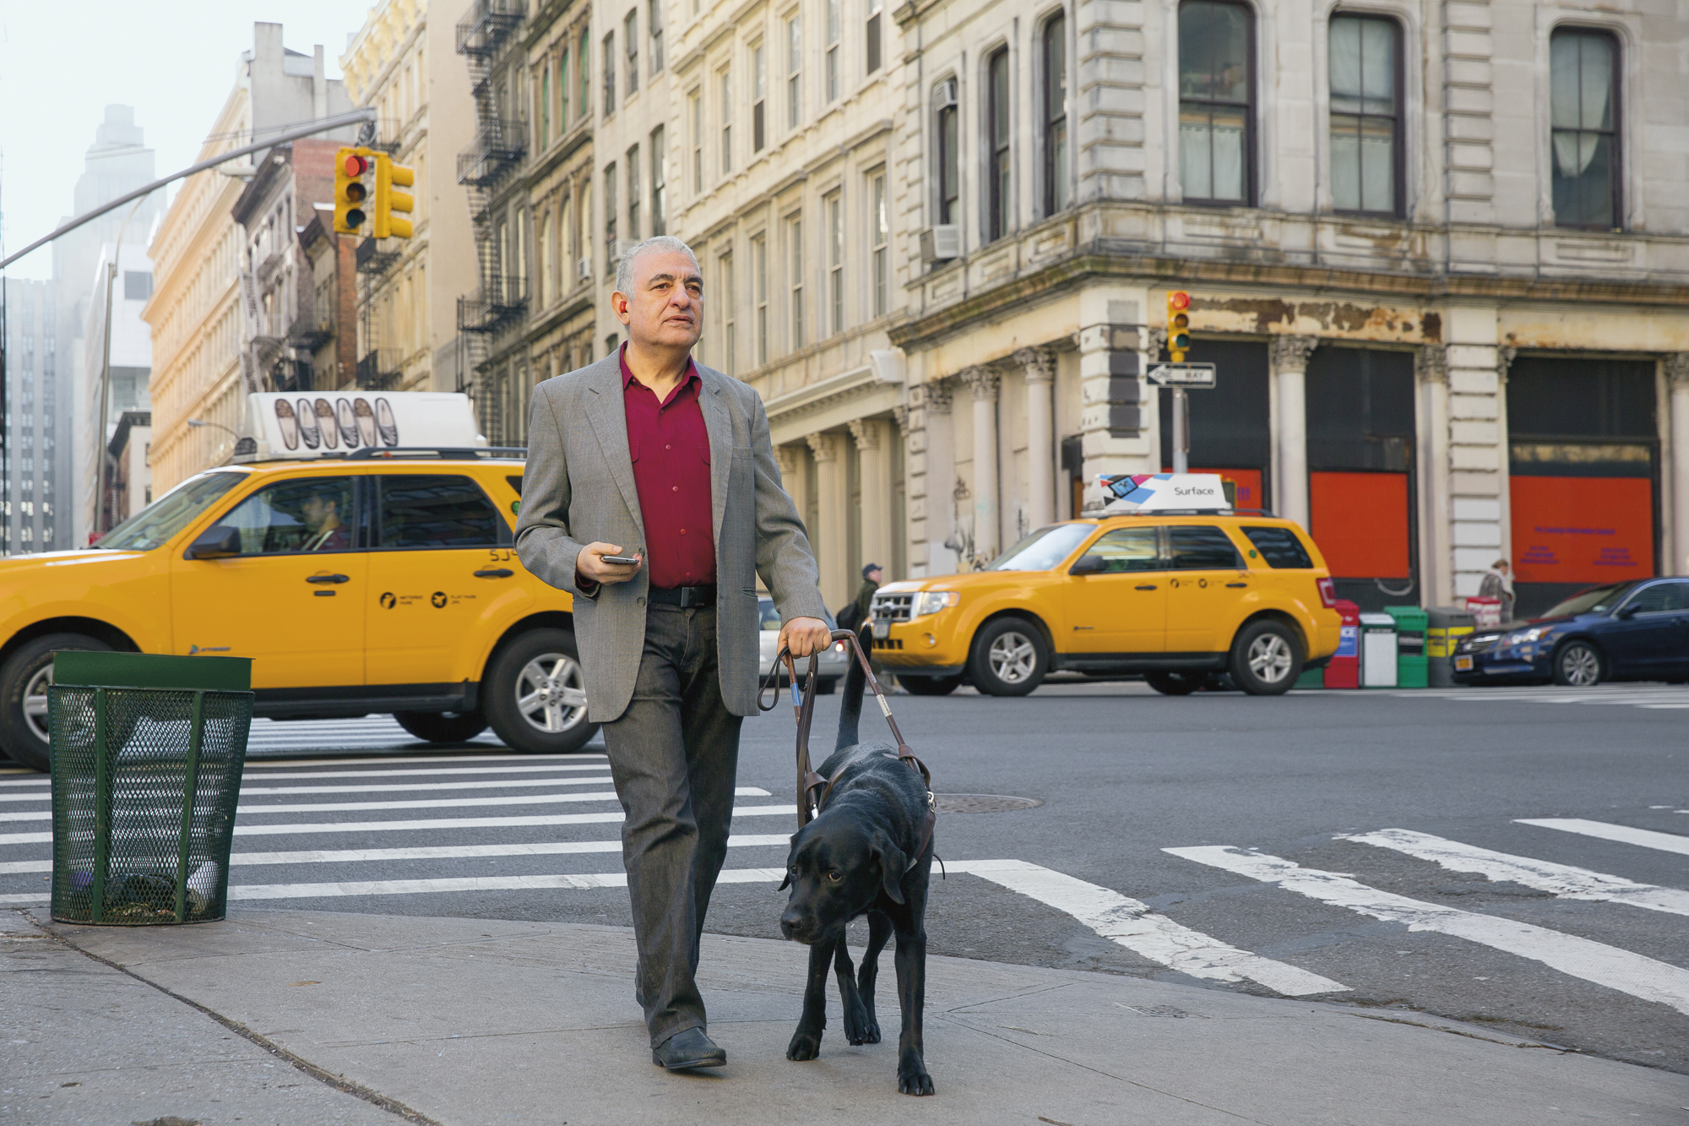
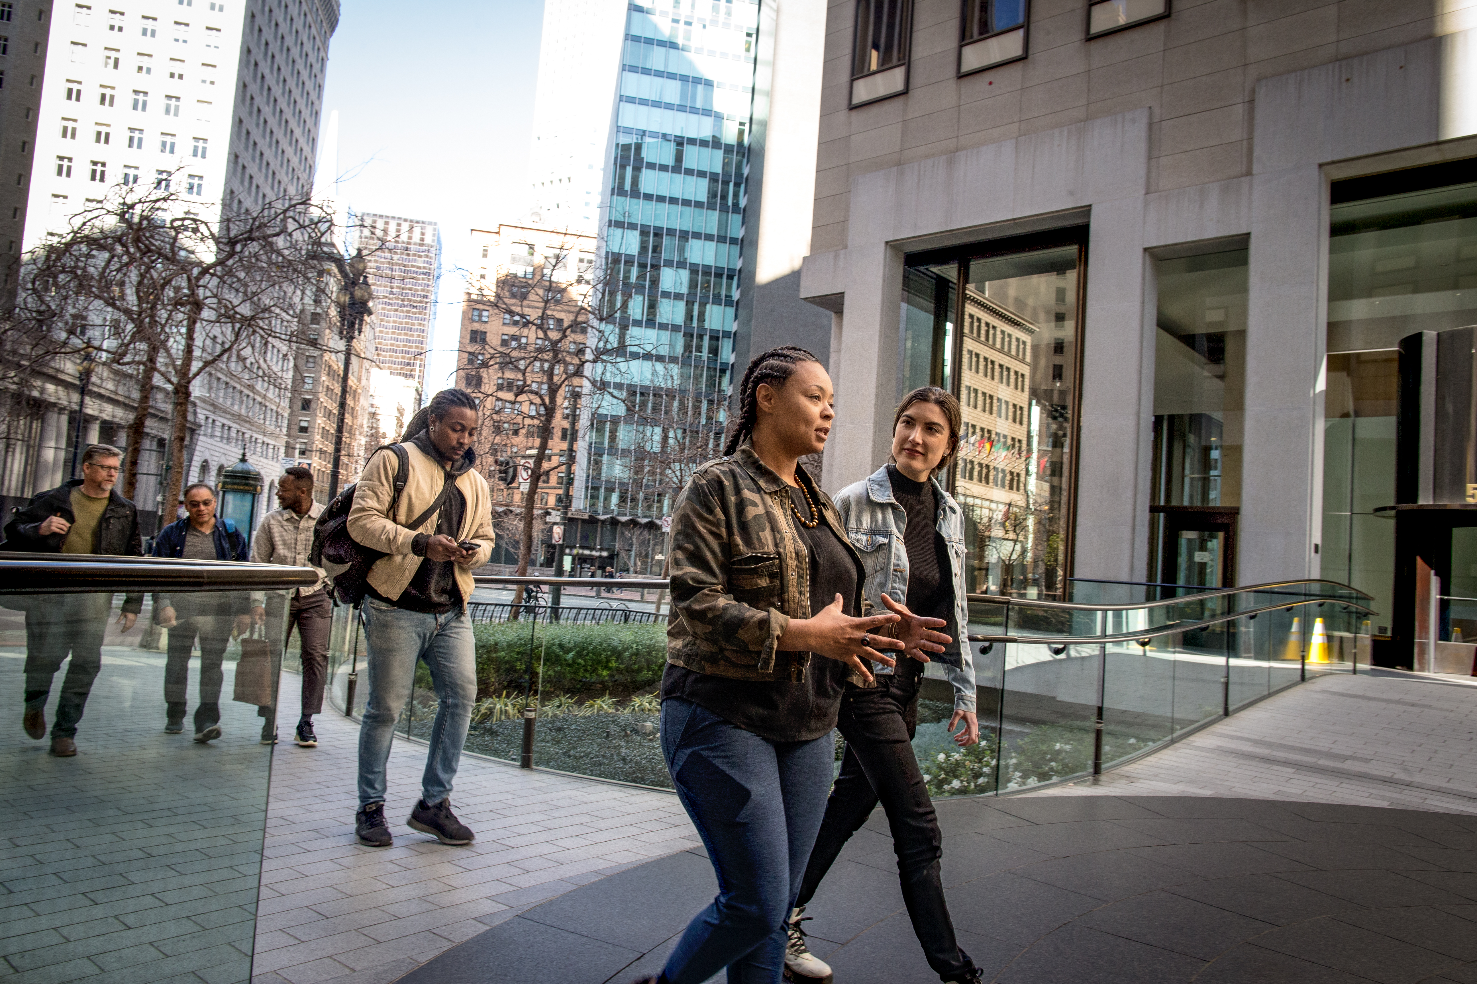

Applications of Computer Vision
Image Classification
Object Detection
Semantic Segmentation
bus
bus
Cyclist
car
bus
Taxi
Cyclist
car
cyclist
Image Analysis
Face Detection & Recognition
Optical Character Recognition
A person with a dog on a street
The Toronto Dominion Bank
Notes:
This is an animated slide – use the notes below to talk to each animation build
Most computer vision solutions are built using a combination of machine learning models and some advanced image analysis techniques. Common applications of computer vision include:
Image classification – An image classification model uses the numeric pixel features to predict a class label for the image. For example, in a traffic monitoring solution you might use an image classification model to classify images based on the type of vehicle they contain, such as taxis, buses, cyclists, and so on. Essentially, image classification models answer the question "what is this an image of?" {An image of a taxi with the label "Taxi" is shown}
Object detection – Object detection models are trained to classify individual objects in the image, and to indicate their location within the image as a bounding box. For example, you could expand the traffic monitoring solution to detect the presence of multiple classes of vehicle in an image. Object detection models are used to answer the question "what objects are in this image, and where are they?" {An image of a street with buses, cars, and cyclists indicated in bounding boxes is shown}
Semantic segmentation – Semantic segmentation models are an advanced kind of model that classify individual pixels in the image based on which object they belong to. For example, the traffic monitoring solution might use a semantic segmentation model to overlay "masks" on the image to indicate pixels that belong to buses, cars, and cyclists with different colors. Semantic segmentation answers the question "which pixels belong to which object?". {An image of a street with buses, cars, and cyclists overlaid with colored masks is shown}
Image Analysis – You can build on object detection and classification models to perform image analysis, generating captions and tags based on the image contents. {An image of a person and a dog on a street is shown with the caption "A person with a dog on a street"}
Face Detection and Recognition - Face detection is used to identify the location of human faces in an image. Further analysis can be performed on facial features to determine gender, emotion, age, and so on; and models can be trained to identify specific individuals based on facial recognition. {An image of a group of people with their faces highlighted is shown}
Optical Character Recognition – An OCR model identifies regions of the image that contain text and extracts them. {An image of a building with the sign "The Toronto Dominion Bank" is shown with the text highlighted}

Slide 6
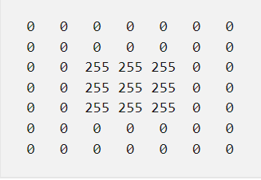

Image as Pixel Array
To a computer, an image is an array of numeric pixel values.
The array consists of rows and columns, representing the pixel values for a N by N pixel image (which is known as the image's resolution).
Each pixel has a value between 0 (black) and 255 (white); with values between these bounds representing shades of gray.

Slide 7
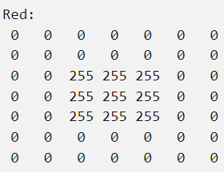
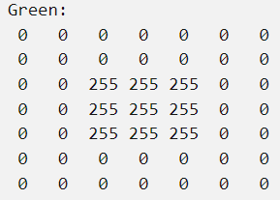
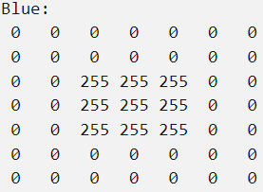
Image as Pixel Array
The array of pixel values is two-dimensional (representing rows and columns, or x and y coordinates) and defines a single rectangle of pixel values.
A single layer of pixel values like this represents a grayscale image.
Most digital images are multidimensional and consist of three layers (known as channels) that represent red, green, and blue (RGB) colour hues.

Slide 8
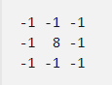
Using filters to process images
A common way to perform image processing tasks is to apply filters that modify the pixel values of the image to create a visual effect. A filter is defined by one or more arrays of pixel values, called filter kernels.
The kernel is then convolved across the image, calculating a weighted sum for each patch of pixels and assigning the result to a new image.
The filter is convolved across the image, calculating a new array of values. The resulting array represents a new image in which the filter has transformed the original image.
Because the filter is convolved across the image, this kind of image manipulation is often referred to as convolutional filtering.
filter with a 3x3 kernel

Slide 9
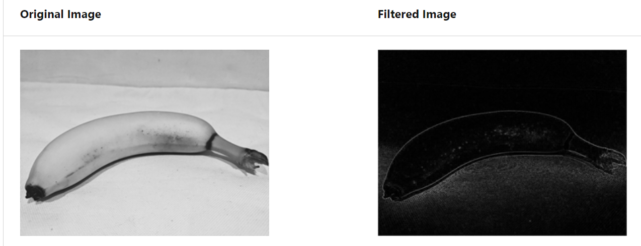
Example

Slide 10
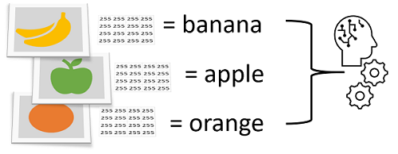
Image Classification
Image classification is a machine learning technique in which the object being classified is an image, such as a photograph.
Image Classification (often referred to as Image Recognition) is the task of associating one (single-label classification) or more (multi-label classification) labels to a given image.
Digital images are made up of an array of pixel values, and these are used as features to train the model based on the known image classes.
The model is trained to match the patterns in the pixel values to a set of class labels. After the model has been trained, you can use it with new sets of features to predict unknown label values

Slide 11
Image Classification
Single-label
Single-label classification is the most common classification task in supervised Image Classification.
As the name suggests, a single label or annotation is present for each image in single-label classification. Therefore, the model outputs a single value or prediction for each image that it sees.
Make sure the score sums up to one and the maximum of the scores is taken to form the model’s output.
Multi-label
Multi-label classification is a classification task where each image can contain more than one label, and some images can contain all the labels simultaneously.
Multi-label classification tasks popularly exist in the medical imaging domain where a patient can have more than one disease to be diagnosed from visual data in the form of X-rays.
In natural surroundings, image labelling can also be framed as a multi-label classification problem, indicating objects present in the images.

Slide 12
Applications
Automated inspection and quality control
Object recognition in driverless cars
Detection of cancer cells in pathology slides
Face recognition in security
Traffic monitoring and congestion detection
Retail customer segmentation
Land use mapping
…….

Slide 13
How does image classification work?
A computer analyses an image in the form of pixels.
It does it by considering the image as an array/matrix of pixels with the size of the matrix reliant on the image resolution.
These pixels will be analysed using AI/ML algorithms.
In digital image processing, image classification is done by automatically grouping pixels into specified categories, so-called “classes.”
The algorithms (such as CNN) segregate the image into a series of its most prominent features, lowering the workload on the final classifier.
These characteristics give the classifier an idea of what the image represents and what class it might be considered into.
The characteristic extraction process makes up the most important step in categorizing an image as the rest of the steps depend on it.

Slide 14
DNNs & CNNs
The most popular machine learning technique for image classification is deep learning, where a lot of hidden layers are used in a model.
Among deep neural networks (DNN), the convolutional neural network (CNN) has demonstrated excellent results in computer vision tasks, especially in image classification.
CNN, or ConvNet is a special type of multi-layer neural network inspired by the mechanism of the optical and neural systems of humans.
CNNs are used to uncover patterns in the pixels that correspond to particular classes. Training an effective CNN is a complex task that requires considerable expertise in data science and machine learning.
Common techniques used to train image classification models have been encapsulated into the Azure AI Custom Vision service in Microsoft Azure;
Azure AI custom vision making it easy to train a model and publish it as a software service with minimal knowledge of deep learning techniques.

Slide 15
DNNs & CNNs

Slide 16
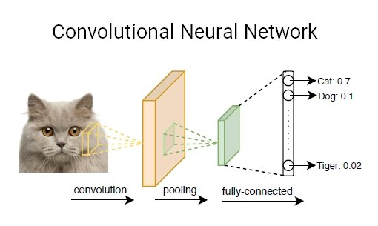
CNN cont.
Convolution Layer: A convolution is the simple application of a filter to an input that results in an activation. The convolution layer has a set of trainable filters that have a small receptive range but can be used to the full-depth of data provided. Convolution layers are the major building blocks used in convolutional neural networks.
Pooling Layer: This layer collects the result of all neurons in the layer preceding it and processes this data. The primary task of a pooling layer is to lower the number of factors being considered and give streamlined output.
Fully-Connected Layer: This layer is the pre-final output layer for CNN models that flattens the input received from layers before it and gives the result.

Slide 17
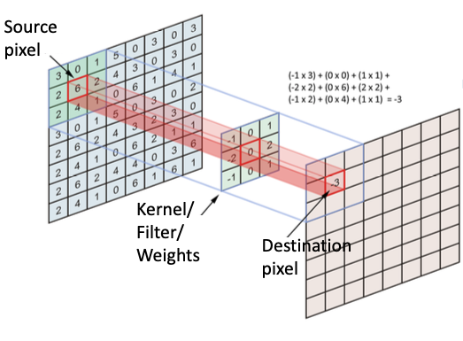
Convolutional Operation
Inner product to produce the feature map

Slide 18
Convolutional Operation

Slide 19
Convolutional Operation

Slide 20
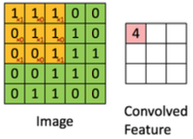
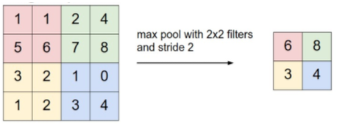
Convolutional Neural Networks (CNN)
Very common in computer vision (also used in time series)
Convolution stage
Pooling/subsampling layer
Max pooling
AVG pooling

Slide 21
Image classification metrics: Accuracy, Error Rate
Classifier accuracy, or recognition rate
Percentage of test set tuples that are correctly classified
Accuracy = (TP + TN)/All
Error rate: 1 – accuracy, or
Error rate = (FP + FN)/All
A\P | C | ¬C
C | TP | FN | P
¬C | FP | TN | N
 | P’ | N’ | All

Slide 22
Recap: Precision and Recall, and F-measures
Precision: Exactness: what % of tuples that the classifier labeled as positive are actually positive?
P = Precision = TP/(TP+FP)
Recall: Completeness: what % of positive tuples did the classifier label as positive?
R = Recall = TP/(TP+FN)
F measure (or F-score): harmonic mean of precision and recall
F1 = 2P*R/(P+R)

Slide 23
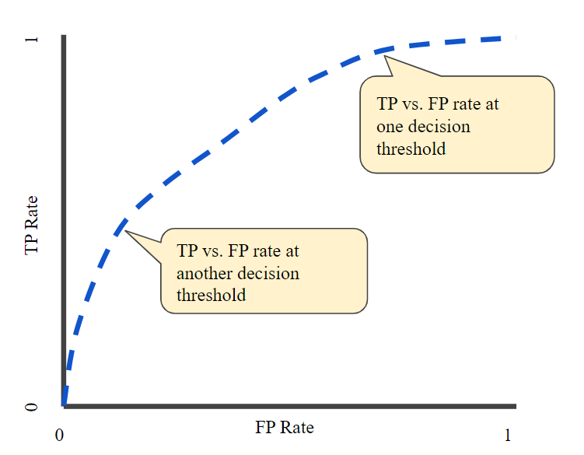
ROC curve
An ROC curve (receiver operating characteristic curve) is a graph showing the performance of a classification model at all classification thresholds. This curve plots two parameters: True Positive Rate and False Positive Rate

Slide 24
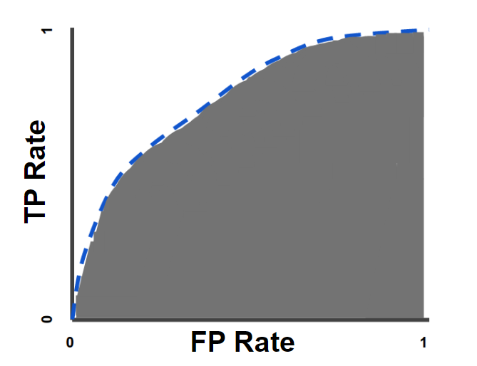
AUC: Area Under the ROC Curve
AUC measures the entire two-dimensional area underneath the entire ROC curve (think integral calculus) from (0,0) to (1,1).

Slide 25
AUC-ROC Curve
ROC (Receiver Operating Characteristic) curve and AUC (Area Under the Curve).
Generate probability values instead of binary 0/1 values
Should be used for roughly balanced data set, and the imbalanced data sets will lead to incorrect interpretation
Provide a good overview of trade-off between the TP rate and FP rate for binary classifier using different probability thresholds
Below 0.5: poor classifier
0.5: random classifier
Over 0.7 corresponds to a good classifier
0.8: strong classifier
1: perfectly predict everything

Slide 26
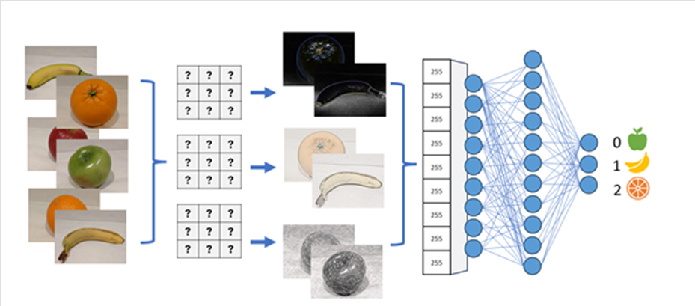
Convolutional Neural Networks (CNNs)
One of the most common machine learning model architectures for computer vision is a convolutional neural network (CNN).
CNNs use filters to extract numeric feature maps from images, and then feed the feature values into a deep learning model to generate a label prediction.

Slide 27

Computer Vision Services in Azure
Computer Vision | Image analysis – automated captioning and tagging Common object detection Face detection Smart cropping Optical character recognition
Custom Vision | Custom image classification Custom object detection
Face | Face detection and analysis
Form Recognizer | Data extraction from forms, invoices, and other documents

Slide 28
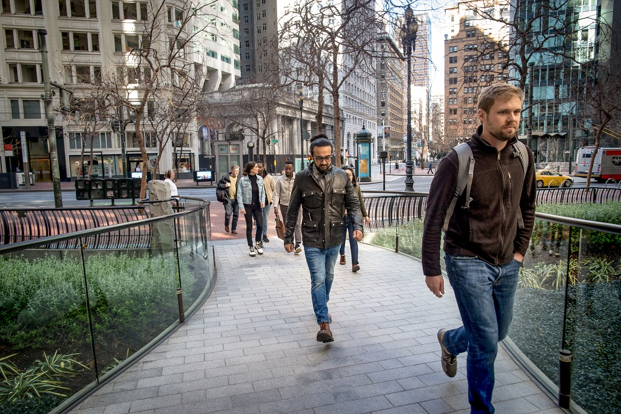
Image Analysis with the Computer Vision Service
Pre-trained computer vision model
Object detection for over 10,000 predefined classes
Image description and tag generation
Face detection and analysis
Content moderation
Text detection and OCR
person
person
male (34)
jeans
footwear
Caption: a group of people walking on a sidewalk
Tags: building, jeans, street, outdoor, jacket, city, person
Ratings: Adult: False, Racy: False, Gore: False

Slide 29
Image Analysis with the Computer Vision Service
The model can:
Detect and locate over 10,000 classes of common object.
Generate an automatic caption for the image and a set of relevant tags that relate to its contents.
Detect and analyze human faces, including gender identification and age estimation.
Enable content moderation by identifying images that contain adult, racy, or gory content.
Detect and extract text in an image (we'll explore this in more depth later in the module).
person
person
male (34)
jeans
footwear
Caption: a group of people walking on a sidewalk
Tags: building, jeans, street, outdoor, jacket, city, person
Ratings: Adult: False, Racy: False, Gore: False

Slide 30
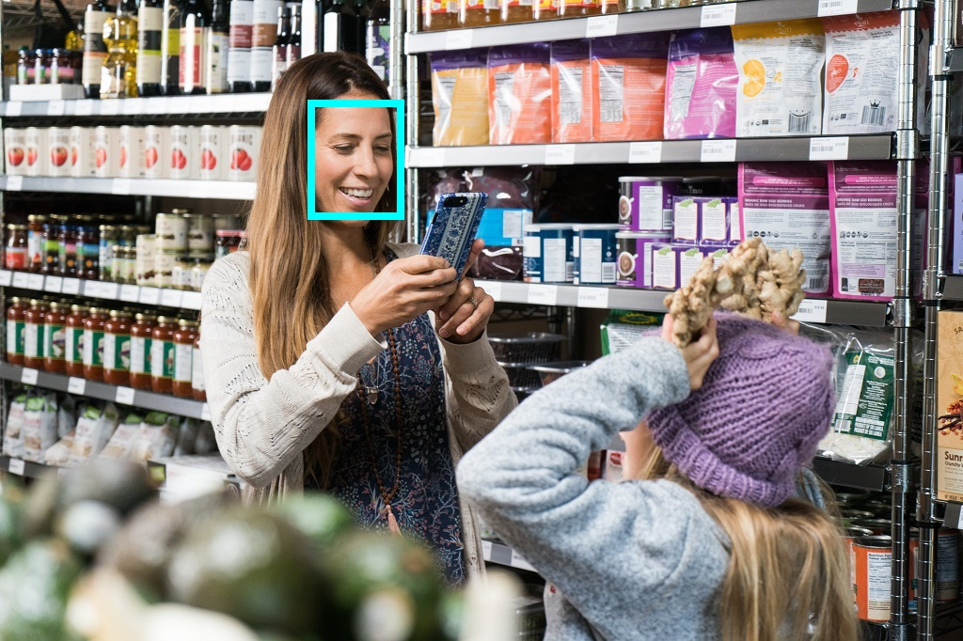
Detecting Faces with the Face Service
Anyone can use the Face service to:
Detect the location of faces in an image
Determine if a face is wearing glasses
Determine if there's occlusion, blur, noise, or over/under exposure for any of the faces
Return the head pose coordinates for each face in an image

Slide 31

Reading Text with the Computer Vision Service
Detect the location of text:
Printed
Handwritten
Options for quick text extraction from images, or asynchronous analysis of larger scanned documents
Shopping List
Non-fat milk
Bread
Eggs

Slide 32
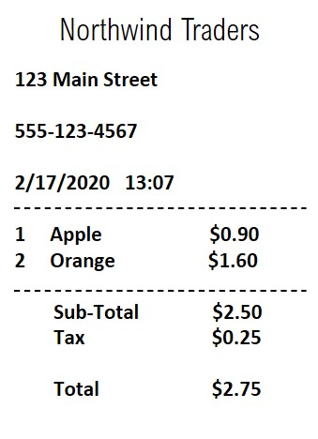
Analyzing Forms with the Form Recognizer Service
Extract information from scanned forms in image or PDF format
Use the pre-trained models for common document types
Train a custom model using your own forms
Models perform semantic recognition of form fields – not just text extraction

